Slide 1
Software Engineering
Introduction to Concurrent Software Systems
CSCI 5828: Foundations of Software Engineering
Lecture 11

Slide 2
Goals
Present an overview of concurrency in software systems
Review the benefits and challenges associated with designing and implementing concurrent software systems
Review material from concurrency textbooks used in previous semesters
“Seven Concurrency Models in Seven Weeks” by Paul Butcher
as well as some material from the book “Programming Concurrency on the JVM” by Venkat Subramaniam
“Java Concurrency in Practice” by Brian Goetz

Slide 3
Why worry about concurrency? (I)
“Concurrency is hard and I’ve only ever needed single-threaded programs. Why should I care about it?”
Changing environment
multi-core computers (including handheld devices)
use of computing clusters to solve problems on the rise
Performance
Growth rates for chip speed are flat;
You can’t wait 18 months for a 2x speed-up anymore
Instead, chips are becoming “wider”
More cores, wider bus (more data at a time), more memory

Slide 4
Why worry about concurrency? (II)
Since chips are not getting faster (in the same way they used to)
a single-threaded, single-process application is not going to see any significant performance gains from new hardware
Instead, software will only see performance gains from new hardware
IF it is designed to do more work in parallel as the number of processors available to it increases
THIS IS NOT EASY
the application’s computations must be amenable to parallelization
that is, it must be possible to break its work into tasks that can run at the same time with no need to coordinate with each other

Slide 5
Why worry about concurrency? (III)
If you can design your system in this way, you pave the way to seeing linear speed ups as the number of processors increases
That is a system on n-cores will be n times faster than the same system running on a single core CPU
In the past few years, laptops are shipping with 8 cores, smartphones with 2-6+ cores, desktops with 8-18 cores, and this is increasing
Some threading frameworks will allow you to send tasks to your machine’s graphics card and these cards can have hundreds to thousands of cores (although, granted, they are designed to be used by very specific types of algorithms)
However, it is very difficult to achieve linear speed-ups, but performance gains can still be quite significant

Slide 6
In addition...
Concurrent programming is becoming hard to ignore
lots of application domains in which concurrency is the norm
Embedded software systems, robotics, “command-and-control”, high- performance computing (use of clusters), …
Web programming often requires concurrency (AJAX)
Web browsers are themselves examples of multi-threaded GUI applications
without threads the UI would block as information is downloaded

Slide 7
BUT...
“A DEEP CHASM OPENS BEFORE YOU...” ‡
Concurrency is HARD
While concurrency is widespread, it is error prone
Programmers trained for single-threaded programming face unfamiliar problems
synchronization, race conditions, deadlocks, “memory barriers”, etc.
Let’s review some terminology
Notes:
‡ — Taken from Cocoa Programming For Mac OS X, 4th Edition by Aaron Hillegass and Adam Preble

Slide 8
Basic Definitions
When we execute a program, we create a process
A sequential program has a single thread of control
A concurrent program has multiple threads of control
A single computer can have multiple processes running at once;
If that machine has a single processor, then the illusion of multiple processes running at once is just that: an illusion
That illusion is maintained by the operating system; it coordinates access to the single processor by the various processes; only one process runs at a time
If a machine has more than a single processor, then true parallelism can occur
you can have N processes running simultaneously on a machine that has N processors

Slide 9
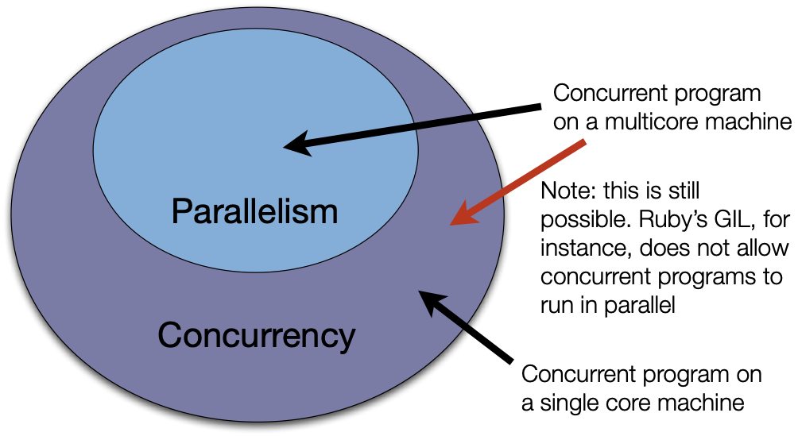
Thus...

Slide 10
Concurrency Textbook Definitions (Adapted)
A concurrent program has multiple logical THREADS OF CONTROL. These threads may or may not run in parallel.
A parallel program has the ability to execute multiple computations simultaneously. It may or may not have more than one logical thread of control (typically it does, but in data parallelism it might not).
Alternative way of thinking about it
Concurrency is part of the problem domain
multiple events can happen at the same time
Parallelism is an aspect of the solution domain
we design a program such that computations occur simultaneously

Slide 11
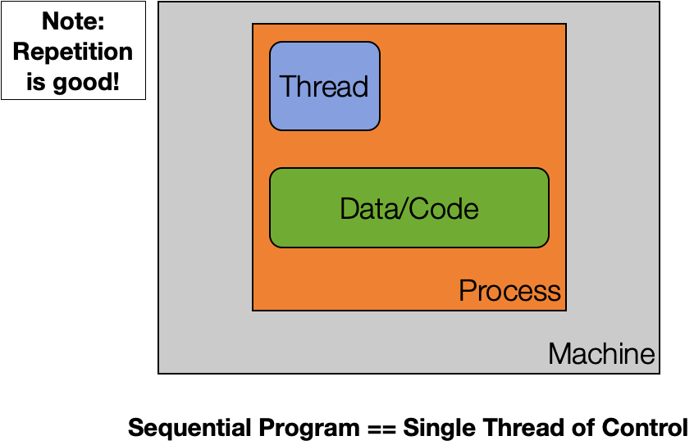
Basics: Single Thread, Single Process, Single Machine

Slide 12
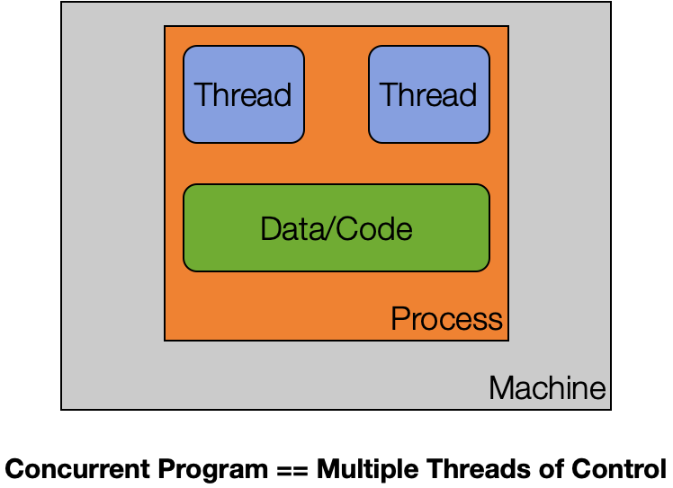
Basics: Multiple Thread, Single Process, Single Machine

Slide 13
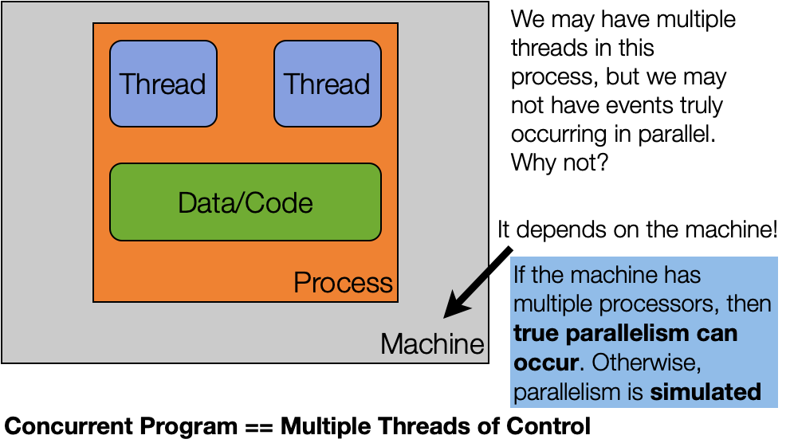
Multi-Thread: But is it truly parallel?

Slide 14
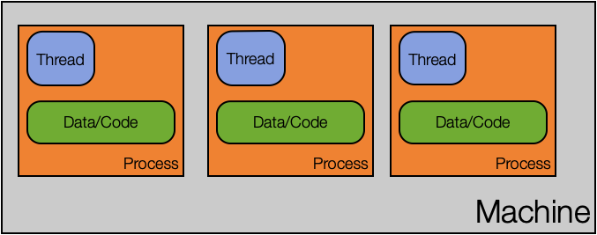
Basics: Single Thread, Multiple Process, Single Machine

Slide 15
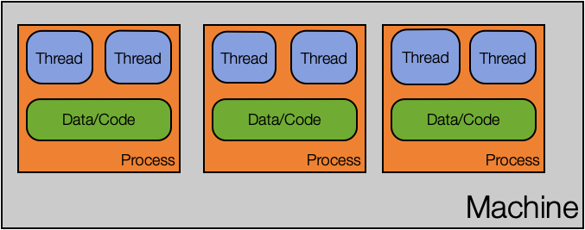
Basics: Multi-thread, Multi-Process, Single Machine
Note: You can have way more than just two threads per process.

Slide 16
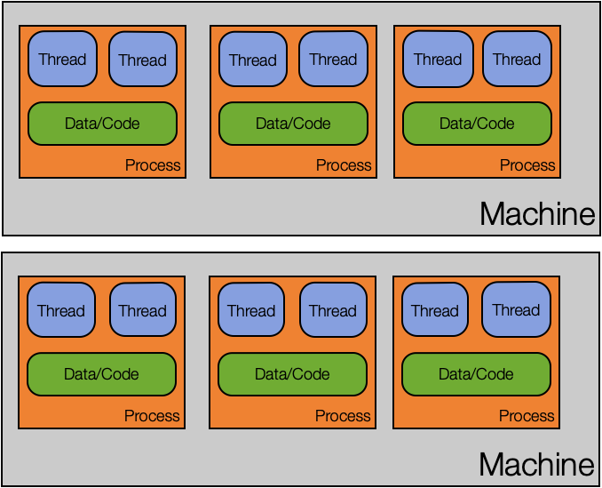
Basics: Multi-everything

Slide 17
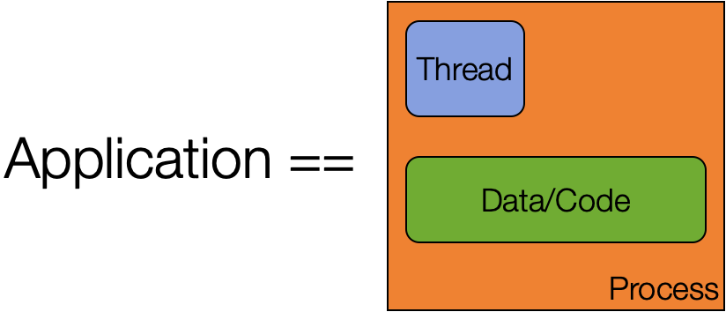
Applications are Dead! Long Live Applications!
Due to the ability to have multiple threads, multiple processes, and multiple machines work together on a single problem, the notion of an application is changing. It used to be that

Slide 18
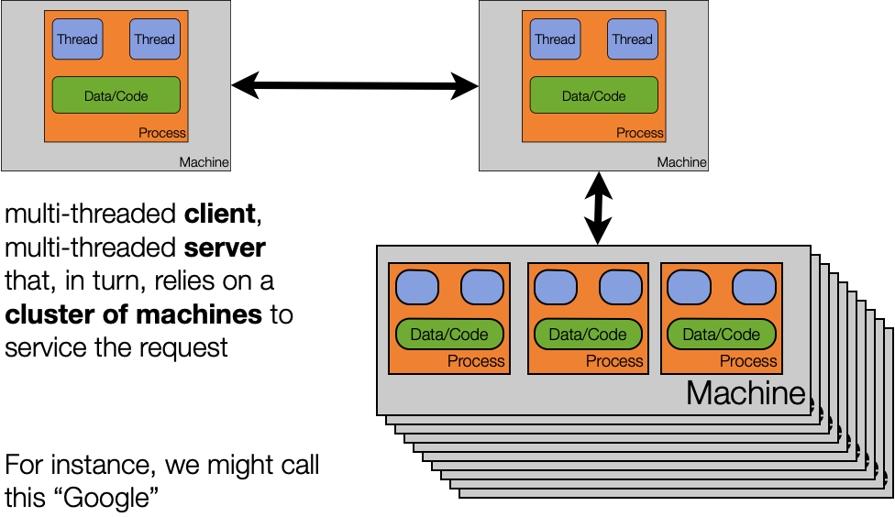
Now... we might refer to this as “an application”

Slide 19
Parallel Architecture
Within a single machine, there are many levels of parallelism which may or may not have an impact on our concurrent systems
Bit-Level Parallelism A 32-bit computer can process 32-bit numbers faster than an 8-bit computer
Instruction-Level Parallelism Processor techniques such as pipelining, out-of-order execution, and speculative execution can impact the behaviors we see in parallel code
Data Parallelism GPUs can process lots of data in parallel with a single instruction
Task-Level Parallelism Multiple threads of control executing simultaneously under a particular memory model (i.e. do we allow threads to share memory or not)

Slide 20
Software Architecture Design Choices
When designing a modern application, we now have to ask
How many machines are involved?
What software components will be deployed on each machine?
For each component
Does it need concurrency?
If so, how will we achieve that concurrency?
multiple threads?
multiple processes?
both?

Slide 21
Consider Chrome
Google made a splash in 2008 by announcing the creation of a new web browser that was
multi-process (one process per tab) and
multi-threaded (multiple threads handle loading of content within each tab)
They documented their engineering choices via a comic book
http://www.google.com/googlebooks/chrome/index.html

Slide 22
Chrome Advantages
Some of the advantages they cite for this design
stability
single-process, multi-threaded browsers are vulnerable to having a crash in one tab bring down the entire browser
speed
multi-process browsers can be more responsive due to OS support
security
exploits in single-process browsers are easier if malware loaded in one tab can grab information contained in another tab; much harder to grab information across processes

Slide 23
Chrome Demo
You can use an operating system’s support for process monitoring to verify that Chrome is indeed multi-process and multi-threaded
This was the result of running Chrome with seven open tabs on OS X

Slide 24
Other benefits to multi-process design
Lots of existing applications that do useful things
Think of all the powerful command line utilities found in Unix-based platforms; You can take advantage of that power in your own application
Create a sub-process, execute the desired tool in that process, send it input, make use of its output
Memory leaks in other programs are not YOUR memory leaks
As soon as the other program is done, kill the sub-process and the OS cleans up
Flexibility: An external process can run as a different user, can run on a different machine, can be written in a different language, ...
Notes:
‡ — Also taken from Cocoa Programming For Mac OS X, 4th Edition by Aaron Hillegass and Adam Preble

Slide 25
Two Reasons for Using Concurrency
Making applications more responsive
Making applications faster
In particular, computationally intensive apps (compute bound) or data processing apps (I/O bound)

Slide 26
The Dangers of Concurrency (I)
Starvation
All threads are active in the system but none of them are making progress
Thread A is waiting for an input that takes a long time to arrive
It’s not blocked but it’s not making progress
Generic solution:
Timeouts: have Thread A do something else once a timeout occurs
Deadlock
Thread A is waiting for B to give up resource C
Thread B is waiting for A to give up resource D
Both are blocked and will never be unblocked
Generic solution: Have threads acquire resources in the same order

Slide 27
The Dangers of Concurrency (II)
Race Conditions
If two threads access the same resource, we may have a race condition
In particular, if two threads have access to the same variable, they may attempt to change its value at the same time
this can result in the value getting set to an inconsistent state
You can also get into problems even when one thread is doing the writing and a second thread is doing the reading

Slide 28
The Dangers of Concurrency (III)
First Example of Race Condition
threads A and B have access to an integer variable C
C currently equals 0 and then both A & B execute the code “C = C + 1”
A reads the value 0 and gets suspended
then B reads the value 0 and updates it to 1
then A wakes up and updates the value to 1
DEMO
Final value should have been 30; typically, the value was much less than that, due to the problem above; note: code had to be made way more complex than normal to make the problem appear consistently

Slide 29
The memory barrier (I)
The term “memory barrier” simply refers to transferring values from main memory into working memory and back again
Each thread has its own flow of execution and this means that it has
its own program stack
its own set of values for the machine’s registers
Each thread also shares access to the program’s heap and static data

Slide 30
The Dangers of Concurrency (IV)
Second Example of Race Condition
Thread A is designed to loop until a boolean variable switches from true to false
Thread B creates A, then goes to sleep for a bit, then changes the boolean variable from true to false
Observed behavior: sometime the program works, sometimes it does not
See example in source code that comes with Programming Concurrency on the JVM
The problem?
Thread A cached the value of the boolean variable and B’s write never “crosses the memory barrier” to allow A to see the updated value

Slide 31
The memory barrier (II)
In order to make a program run faster, the compiler will look for ways to optimize memory reads/writes.
It may choose to cache a value stored in main memory into its set of registers
once that occurs, only certain types of operations will cause a change in the cached value to be synced back to its home in main memory
If the cached value corresponds to a value accessed by more than one thread, then problems can occur when changes made by one thread to shared memory are not made visible to another thread

Slide 32
The memory barrier (III)
To avoid the race condition in our second example, we must do something to ensure that B’s change to the shared boolean variable is made visible to A
Examples of techniques that cause the write to pass the memory barrier
Tagging the variable with the keyword volatile
Tagging methods that access the variable with the keyword “synchronized”
Creating a synchronized block on an object and updating the shared variable within that block
As we have seen, having values that can be changed, shared between multiple threads (a.k.a. shared mutability) can lead to incorrect behavior, unstable systems, crashes, locked apps, etc.

Slide 33
The Response: Avoid Shared Mutability
To get around the problems associated with shared mutability, we must
AVOID SHARED MUTABILITY
As the Programming Concurrency on the JVM textbook author says
“Shared mutability is pure evil. Avoid it!”

Slide 34
Summary
Introduced the subject of concurrency in software systems
why it is important
why we cannot really avoid it
what problems occur when dealing with concurrency
starvation, deadlock, race conditions
learned about shared mutability and why to avoid it
learned about the “memory barrier” which is related to Java’s memory model and contributes to some of the problems of shared mutability

